Slide 1
ME 233 Advanced Control II Lecture 21 Stability Analysis of a discrete-time Series-Parallel Least Squares Parameter Identification Algorithm
TexPoint fonts used in EMF.
Read the TexPoint manual before you delete this box.: AA

Slide 2
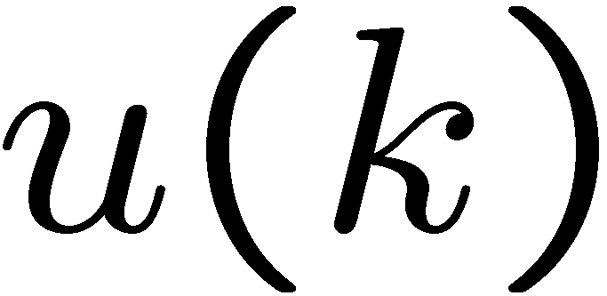
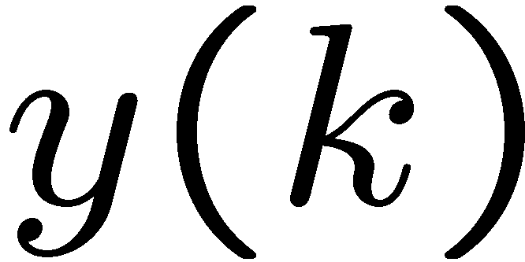
ARMA Model
Consider the following system
Where
known bounded input
measured output

Slide 3
ARMA Model
Orders n and m are known
a’s and b’s are unknown but constant coefficients
(anti-Schur)

Slide 4
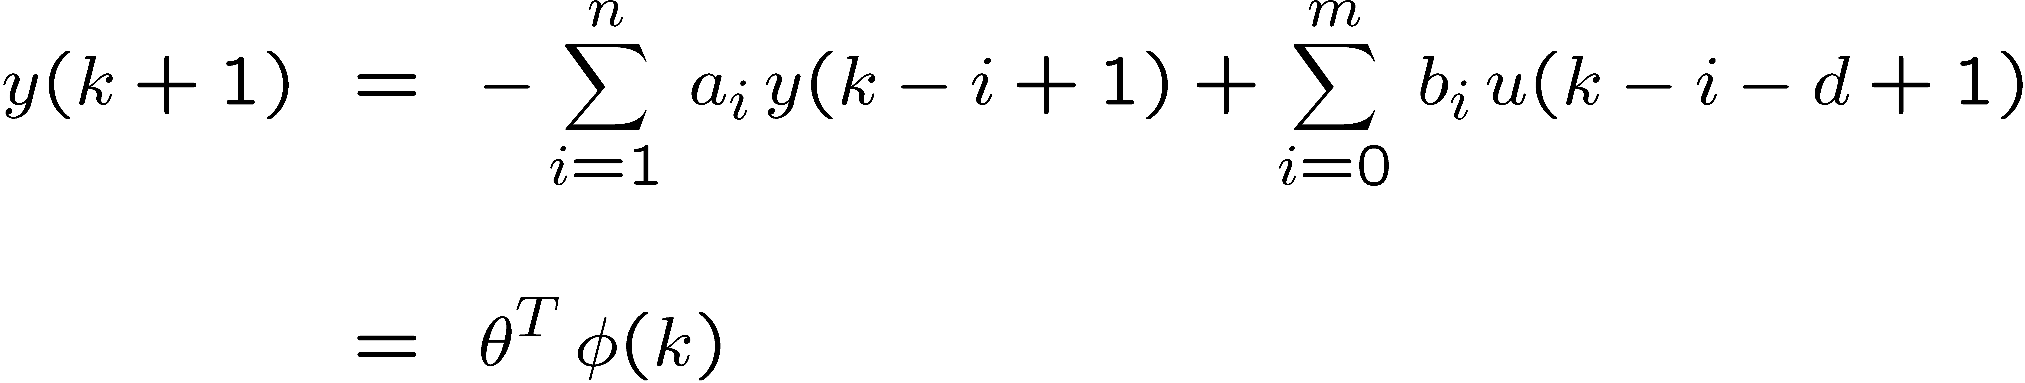
ARMA Model
ARMA model can be written as:
Where:

Slide 5
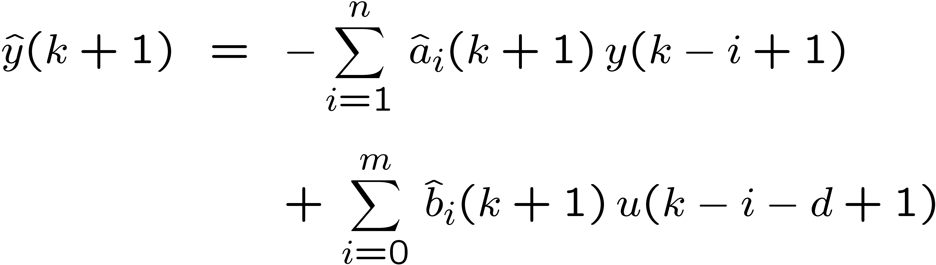
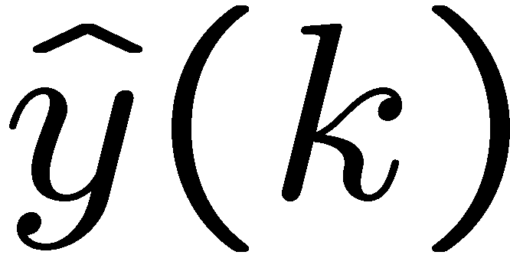
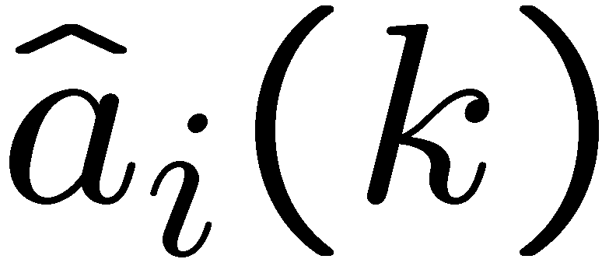
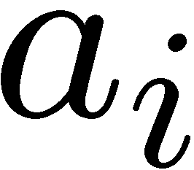
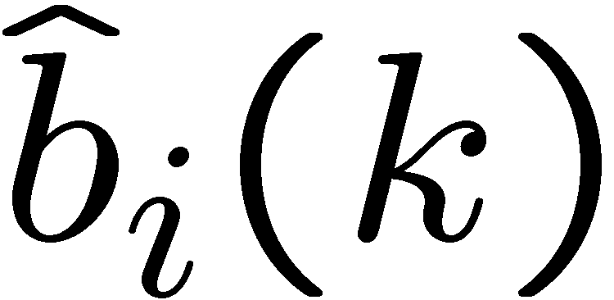
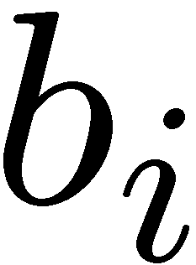
Series-parallel estimation model
A-posteriori series-parallel estimation model
Where
a-posteriori estimate of
estimate of at sampling time k
estimate of at sampling time k

Slide 6
Series-parallel estimation model
A-posteriori series-parallel estimation model
Where
a-posteriori estimate of

Slide 7
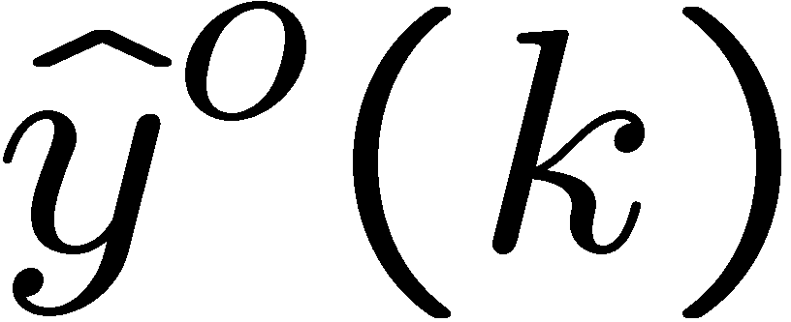
Series-parallel estimation model
A-priori series-parallel estimation model
Where
a-priori estimate of

Slide 8
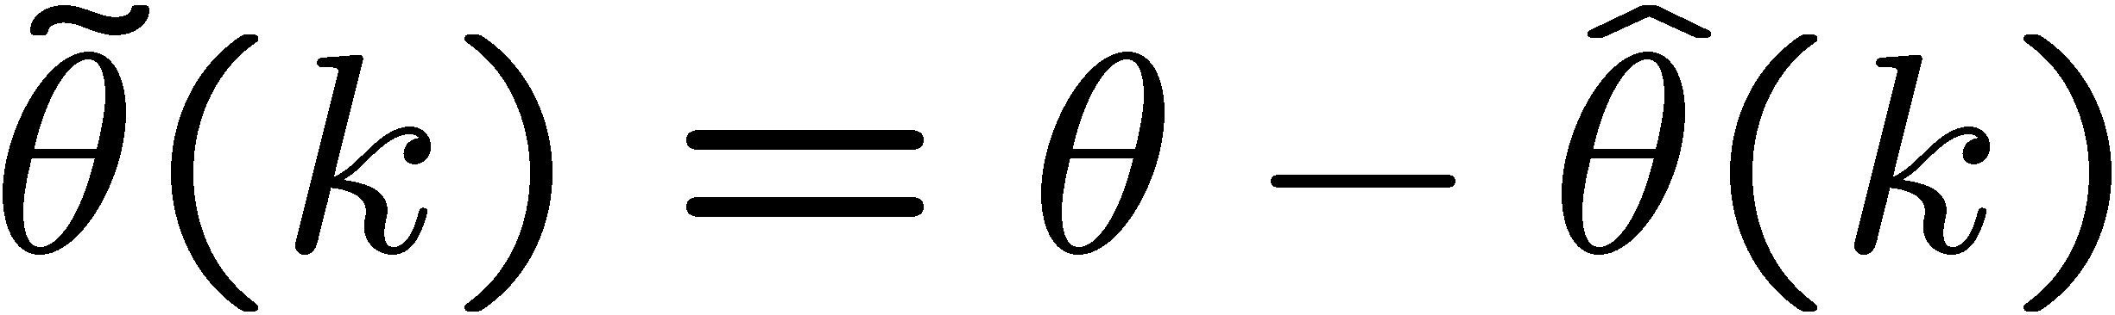
Additional Notation
Unknown parameter vector:
Parameter vector estimate:
Parameter error estimate:
Regressor vector:

Slide 9
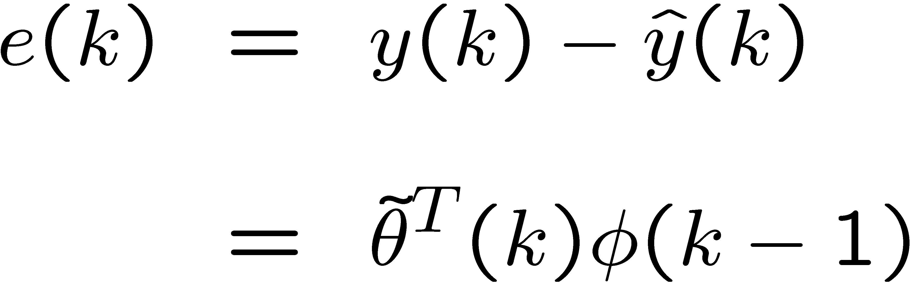
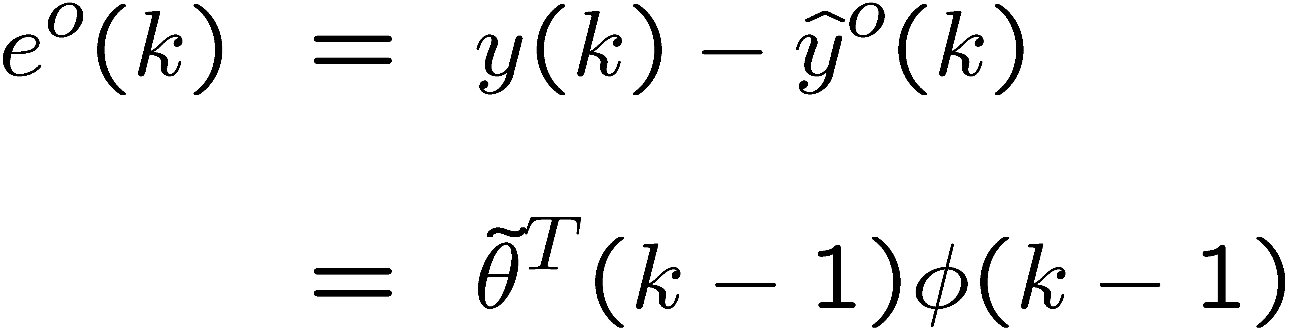
Additional Notation
A-posteriori output estimation error:
A-priori output estimation error:

Slide 10
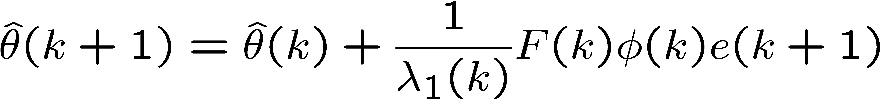
Parameter Adaptation Algorithm (PAA)
A-posteriori version
Parameter estimate update
Gain update
We make the restriction

Slide 11
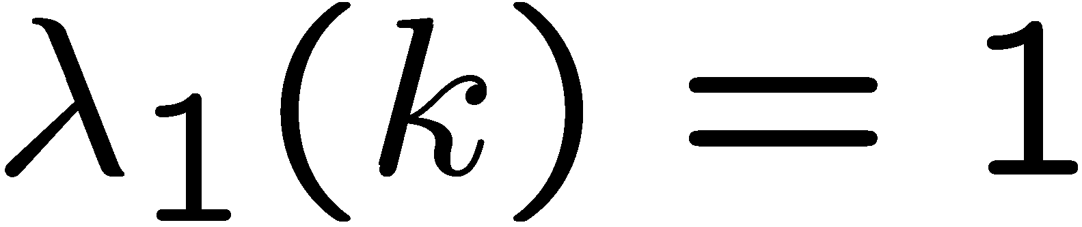
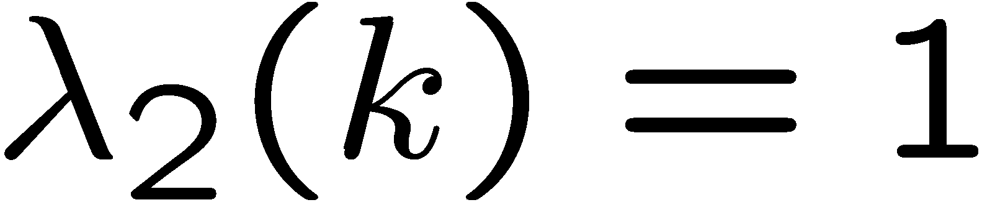
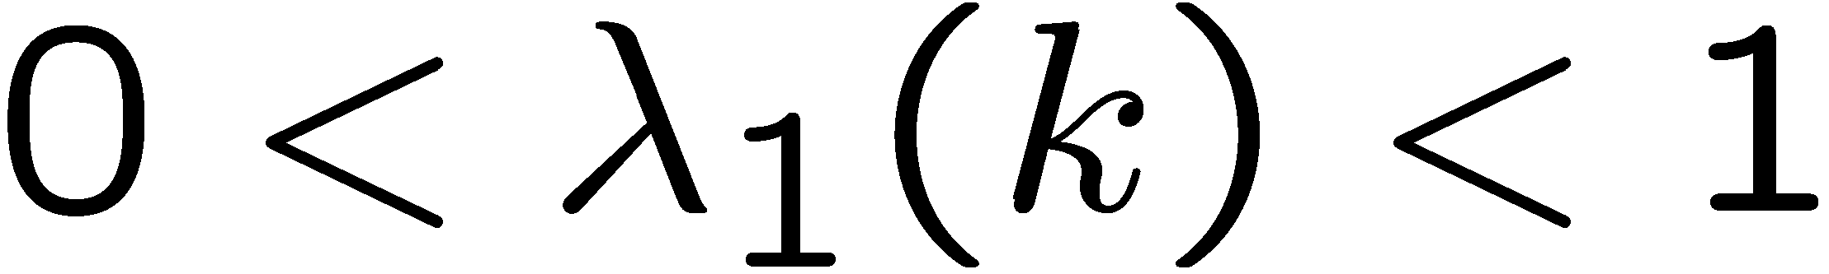

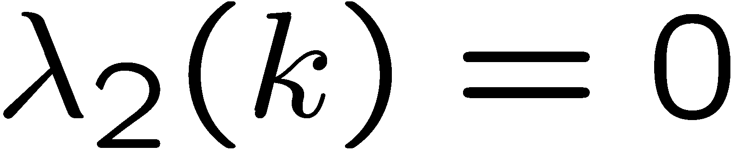
PAA Special Cases
Least squares
Least squares with forgetting factor
Constant gain

Slide 12
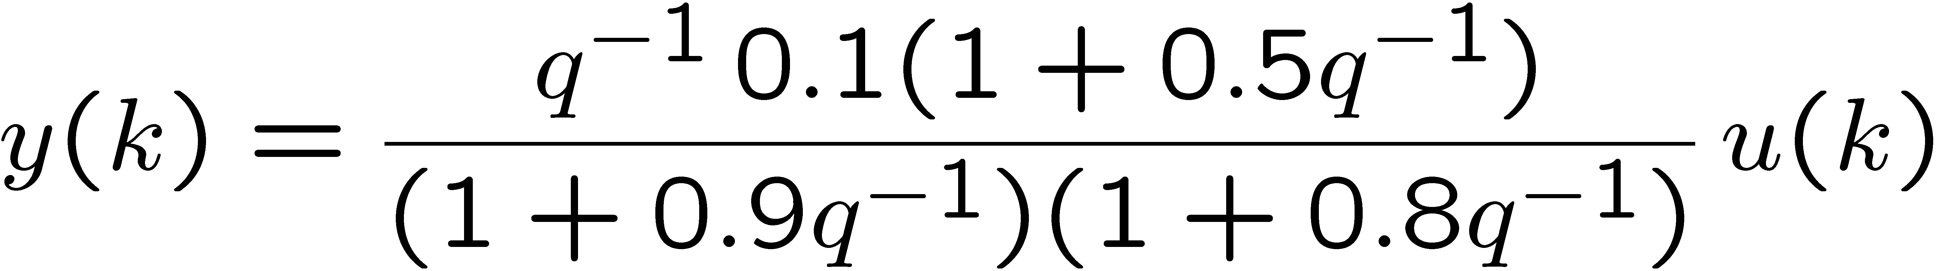
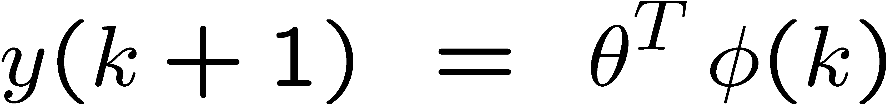
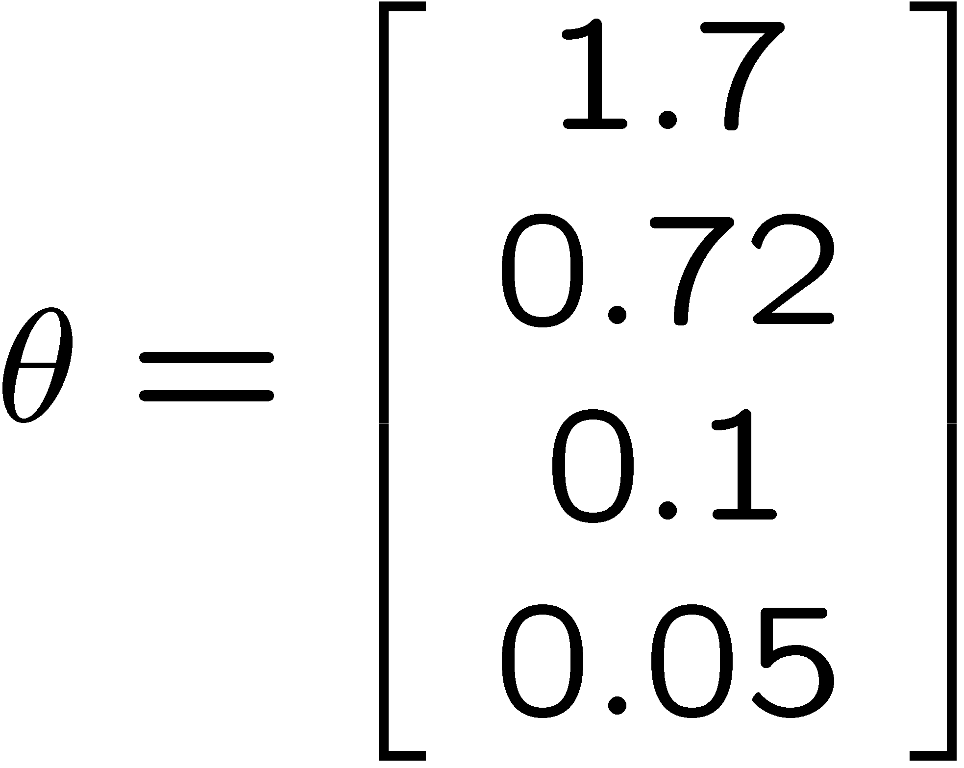
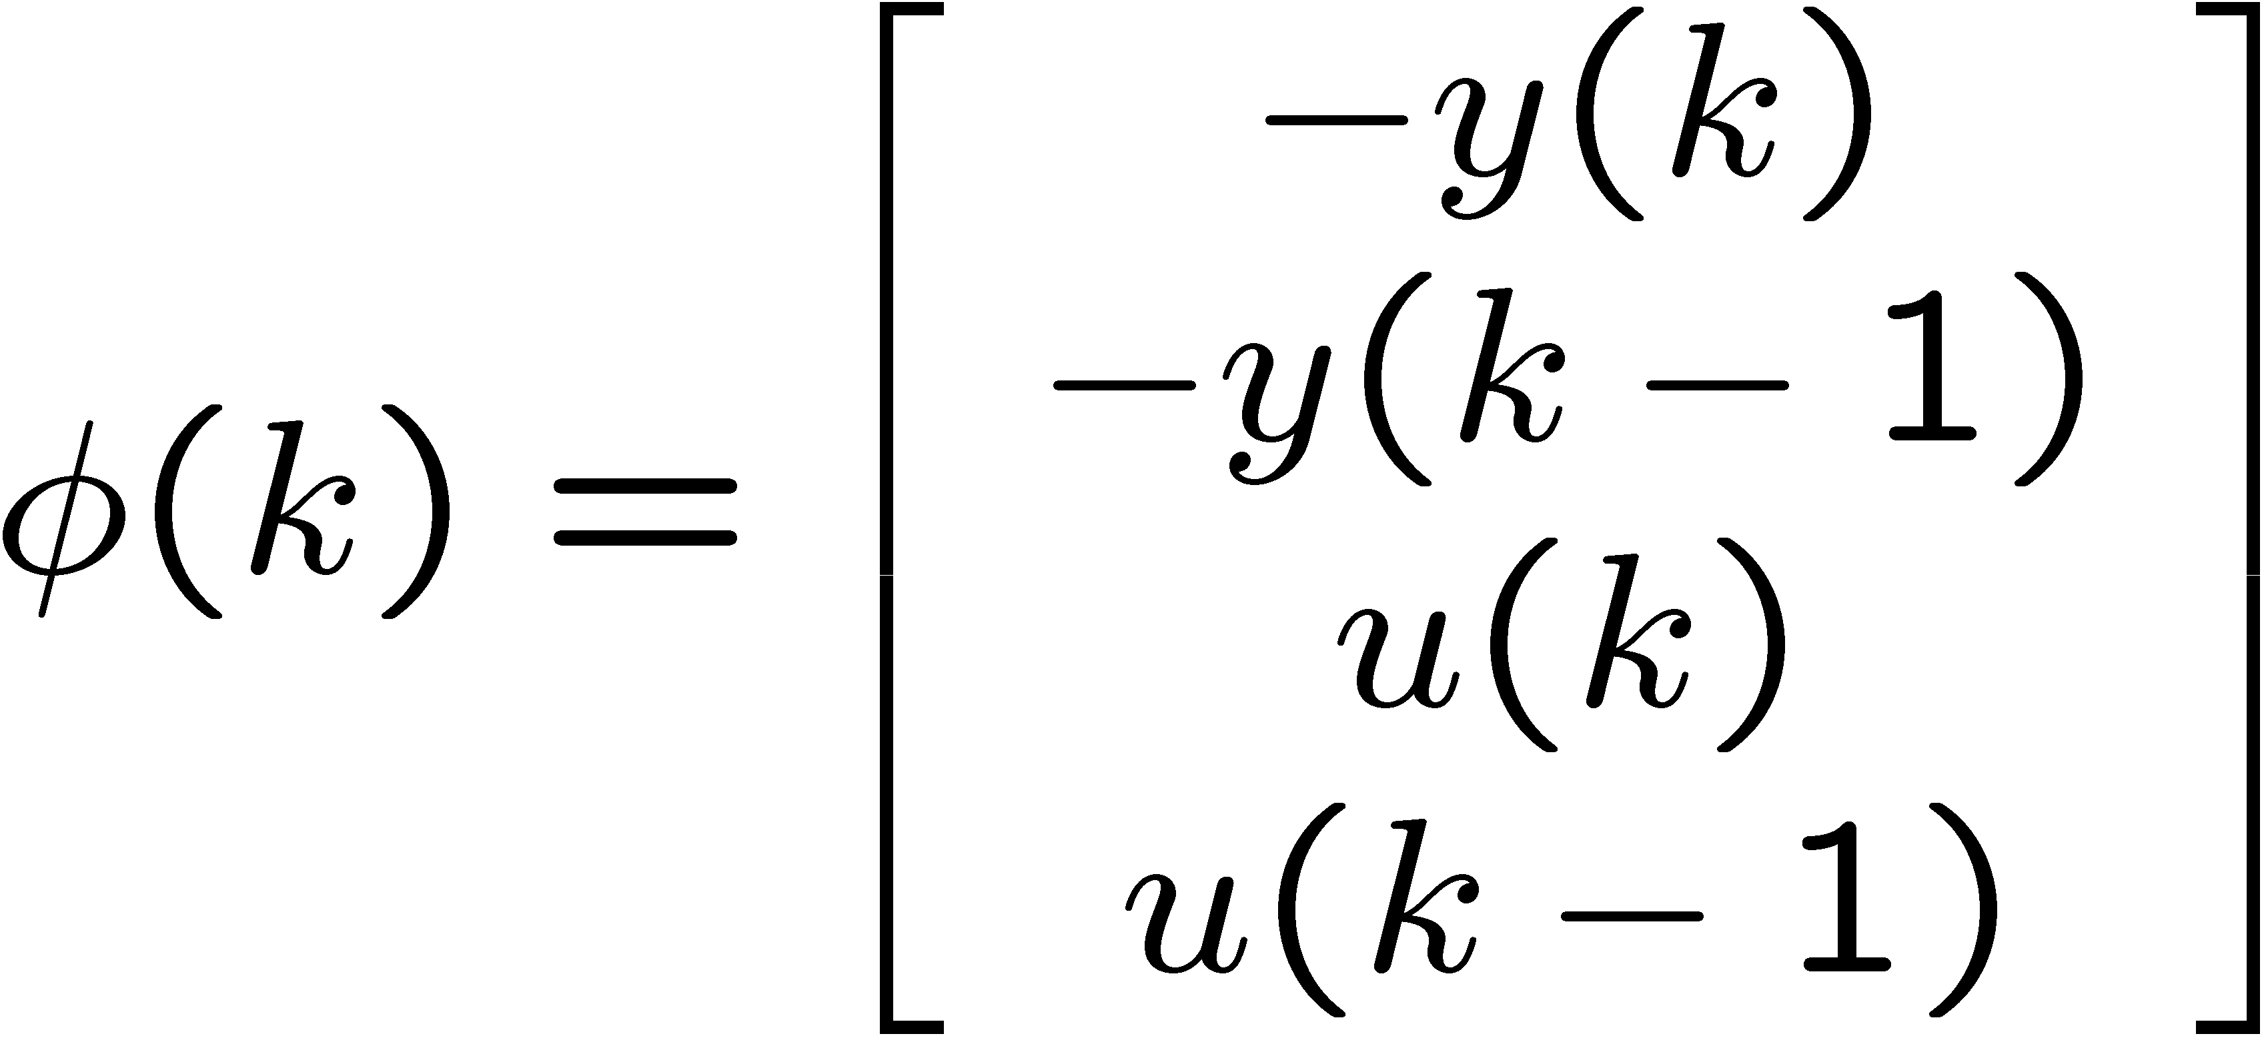
Example
Plant:

Slide 13
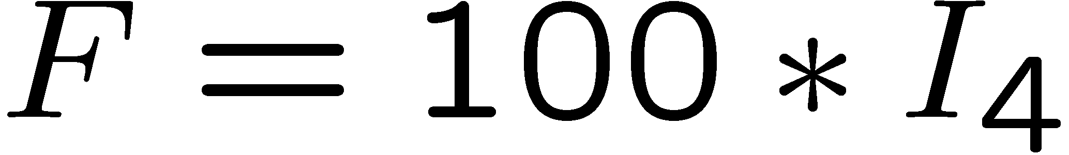
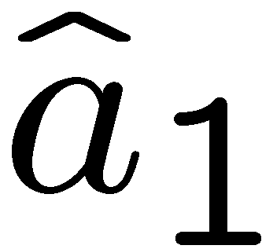
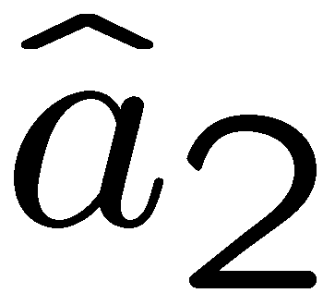
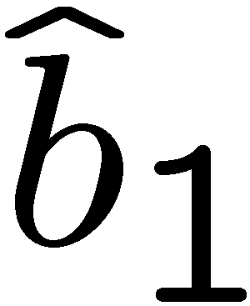
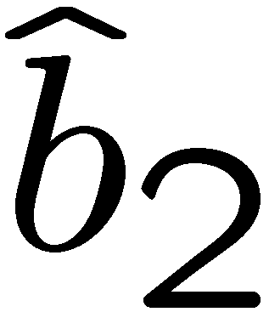
Example: Constant gain
u(k) : zero mean uniform white noise between [-1,1]
parameter convergence
a-priori error

Slide 14
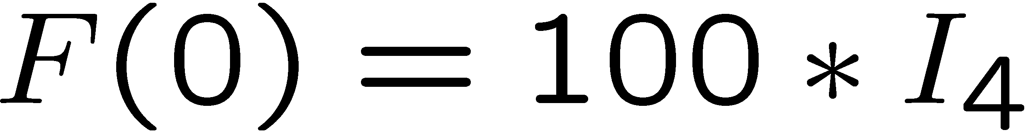
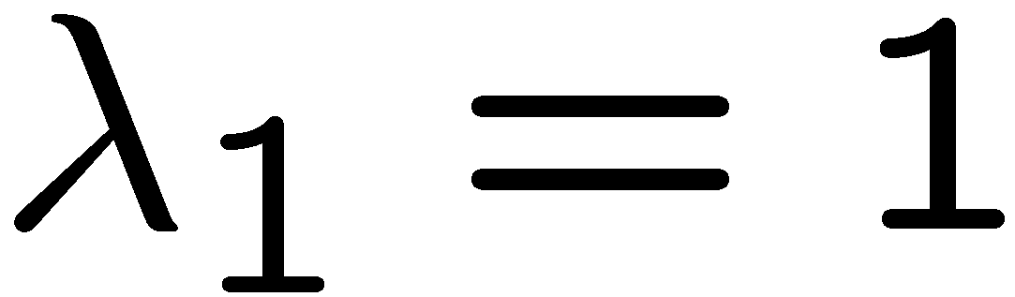
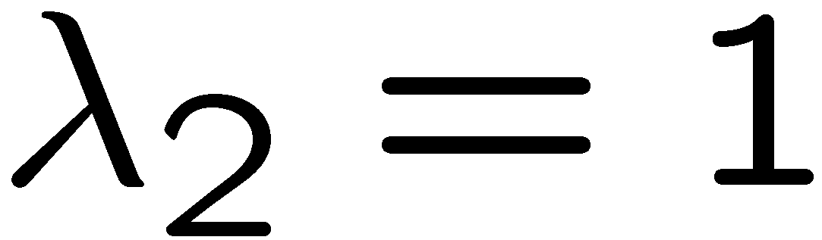
Example: Least Squares
u(k) : zero mean uniform white noise between [-1,1]
parameter convergence
a-priori error

Slide 15
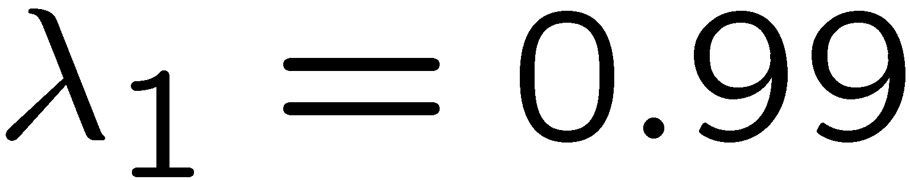
Example: Least Squares & forgetting factor
u(k) : zero mean uniform white noise between [-1,1]
parameter convergence
a-priori error

Slide 16

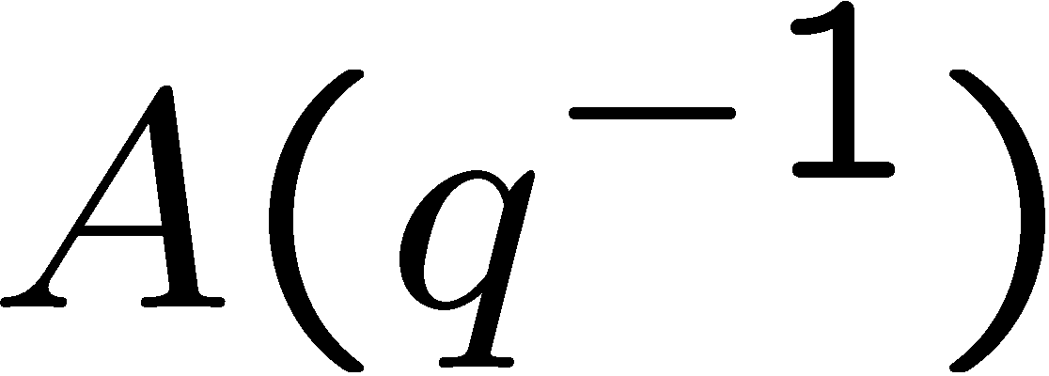
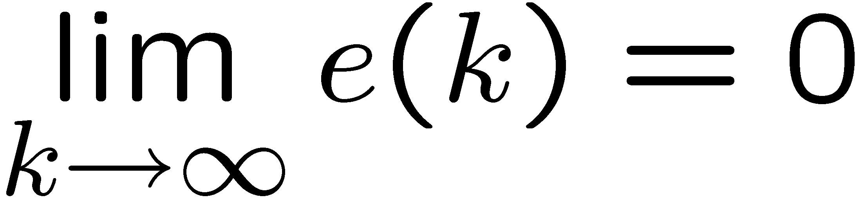
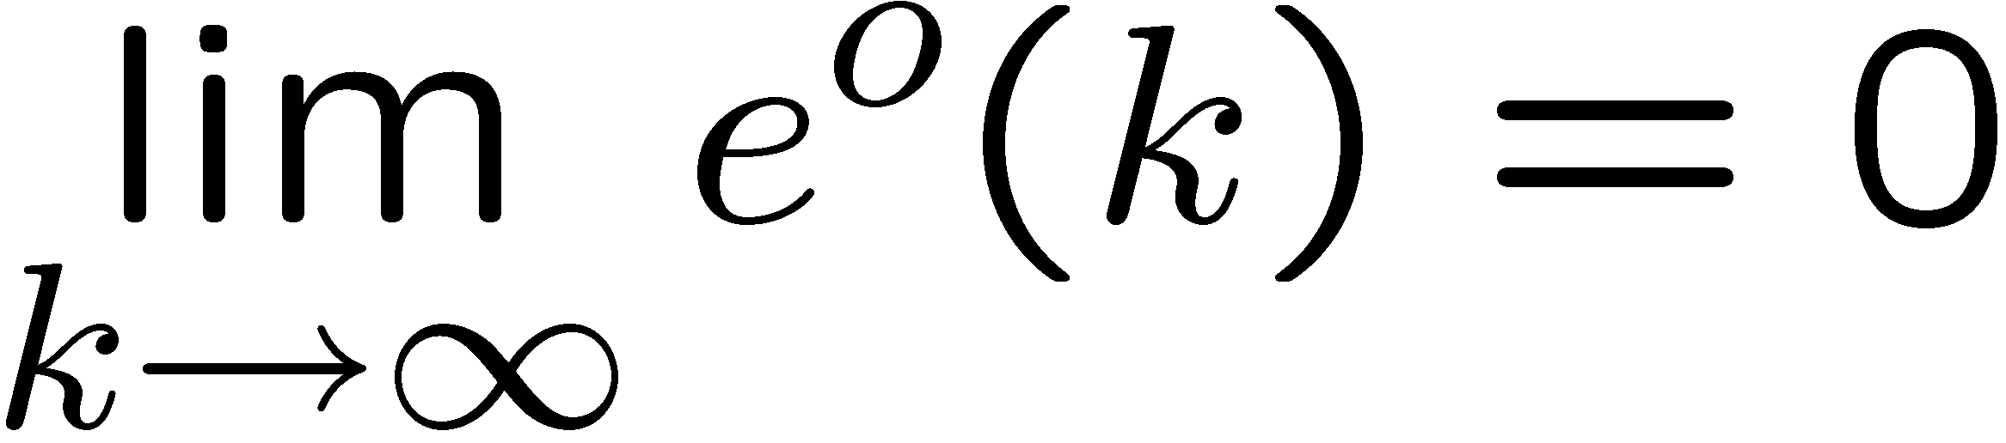
Theorem
Under the following conditions:
The input u(k) is bounded, i.e.
is anti-Schur
Maximum singular value of F(k) is uniformly bounded
and

Slide 17

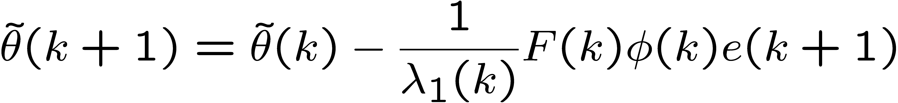
Parameter Adaptation Algorithm (PAA)
Since the unknown parameters are constant and
the PAA
implies that

Slide 18
A-posteriori dynamics
Error dynamics
PAA

Slide 19

Equivalent Feedback Loop
1

Slide 20
Equivalent Feedback Loop
1
NL:

Slide 21
Stability analysis using Hyperstability
Verify that the LTI dynamics are SPR
Verify that the PAA dynamics are P-class
1

Slide 22

Good News: LTI “very” SPR
Verify that the LTI dynamics are SPR
1
Always SPR

Slide 23
Bad News: NL is not P-class
Unfortunately the NL block is not P-class
1
NL:

Slide 24
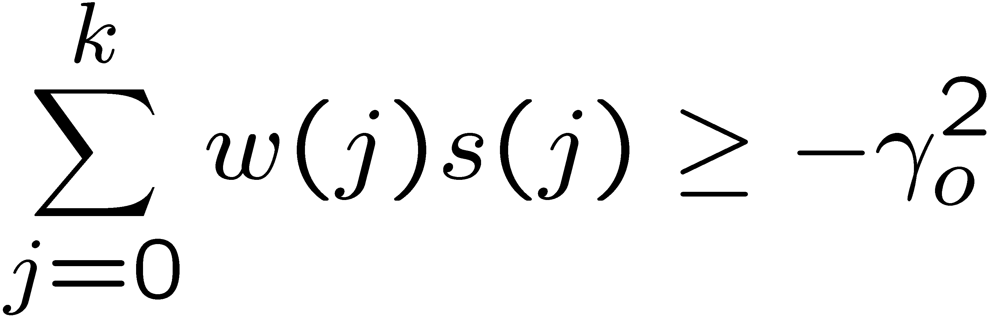
Solution: Modify the NL block
Add a feedback term to NL to make it P-class
NL1:

Slide 25
Modifying the NL block
Add a feedback term to NL to make it P-class
NL1:
Proof: See Additional Material at end of this lecture
(the class notes on bSpace are incorrect)

Slide 26
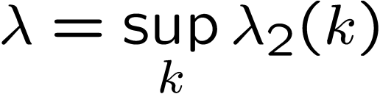
What happens to the feedback structure?
Add and subtract the same blocks:
1
1
=
= 0
= 0

Slide 27
What happens to the feedback structure?
Rearranging blocks,
1
1
=

Slide 28
What happens to the feedback structure?
Rearranging blocks,
1
1
NL₁

Slide 29
What happens to the feedback structure?
Rearranging blocks,
1
1
L₂

Slide 30
What happens to the feedback structure?
Rearranging blocks,
1
1
L₁

Slide 31
Can we now use Hyperstability Theory?
1
For Asymptotic Hyperstability:
L₁ must be SPR
NL₂ must be
P-class

Slide 32
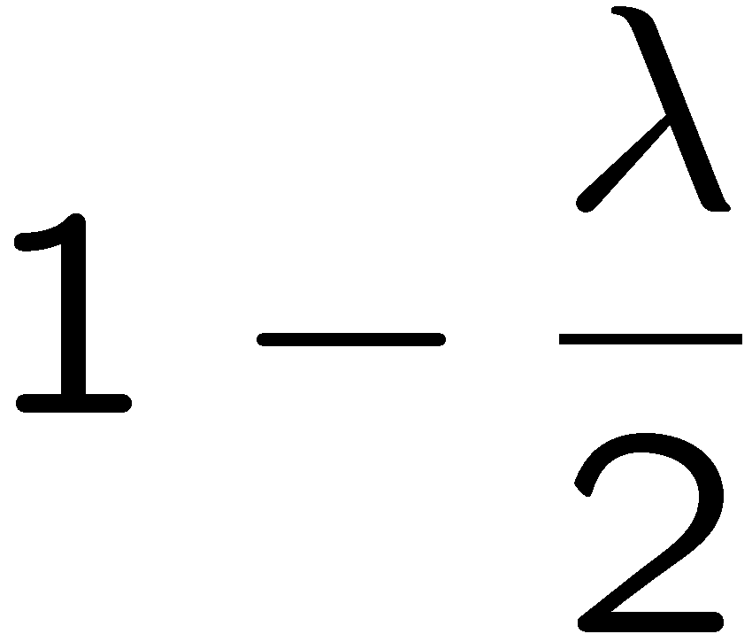
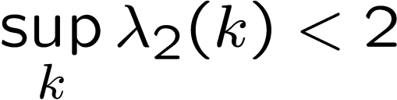
Linear Block L₁
1
Since:
L_{1:}
L₁ is SPR iff

Slide 33
Nonlinear Block NL₂
1
NL₂ :
NL₁ : P-class
L₂ : P-class
Feedback combination
of two blocks:
Therefore NL₂ is P-class

Slide 34
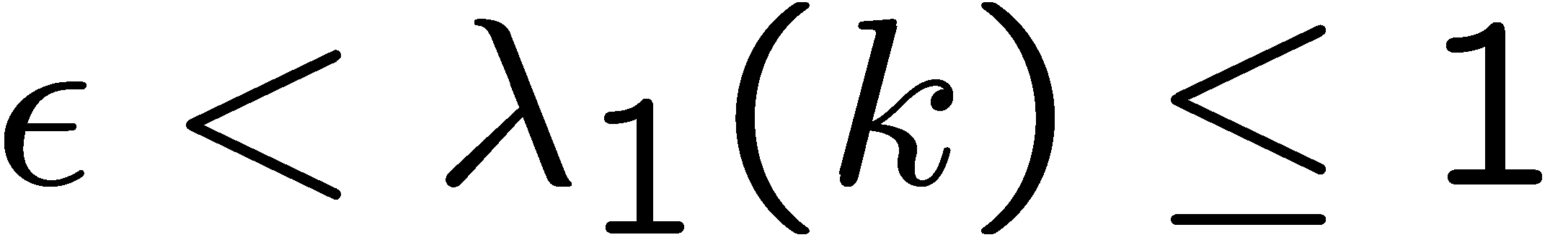
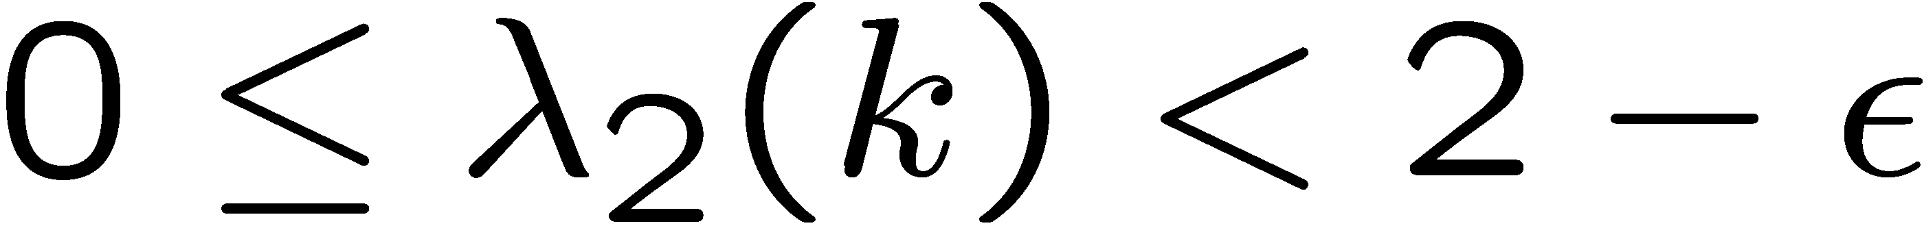

Hyperstability Theorem
If
Then
L₁ is SPR
NL₂ is P-class
Therefore:
1
for some
The interconnection is asymptotically hyperstable

Slide 35
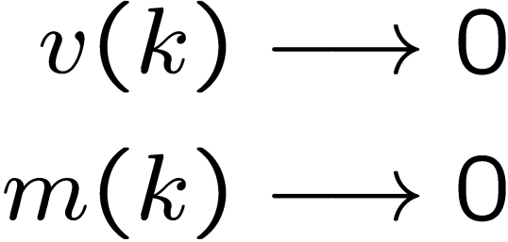

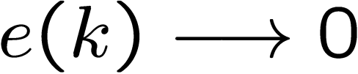
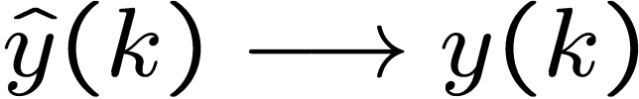
Hyperstability Theorem
If
Then
1
for some

Slide 36
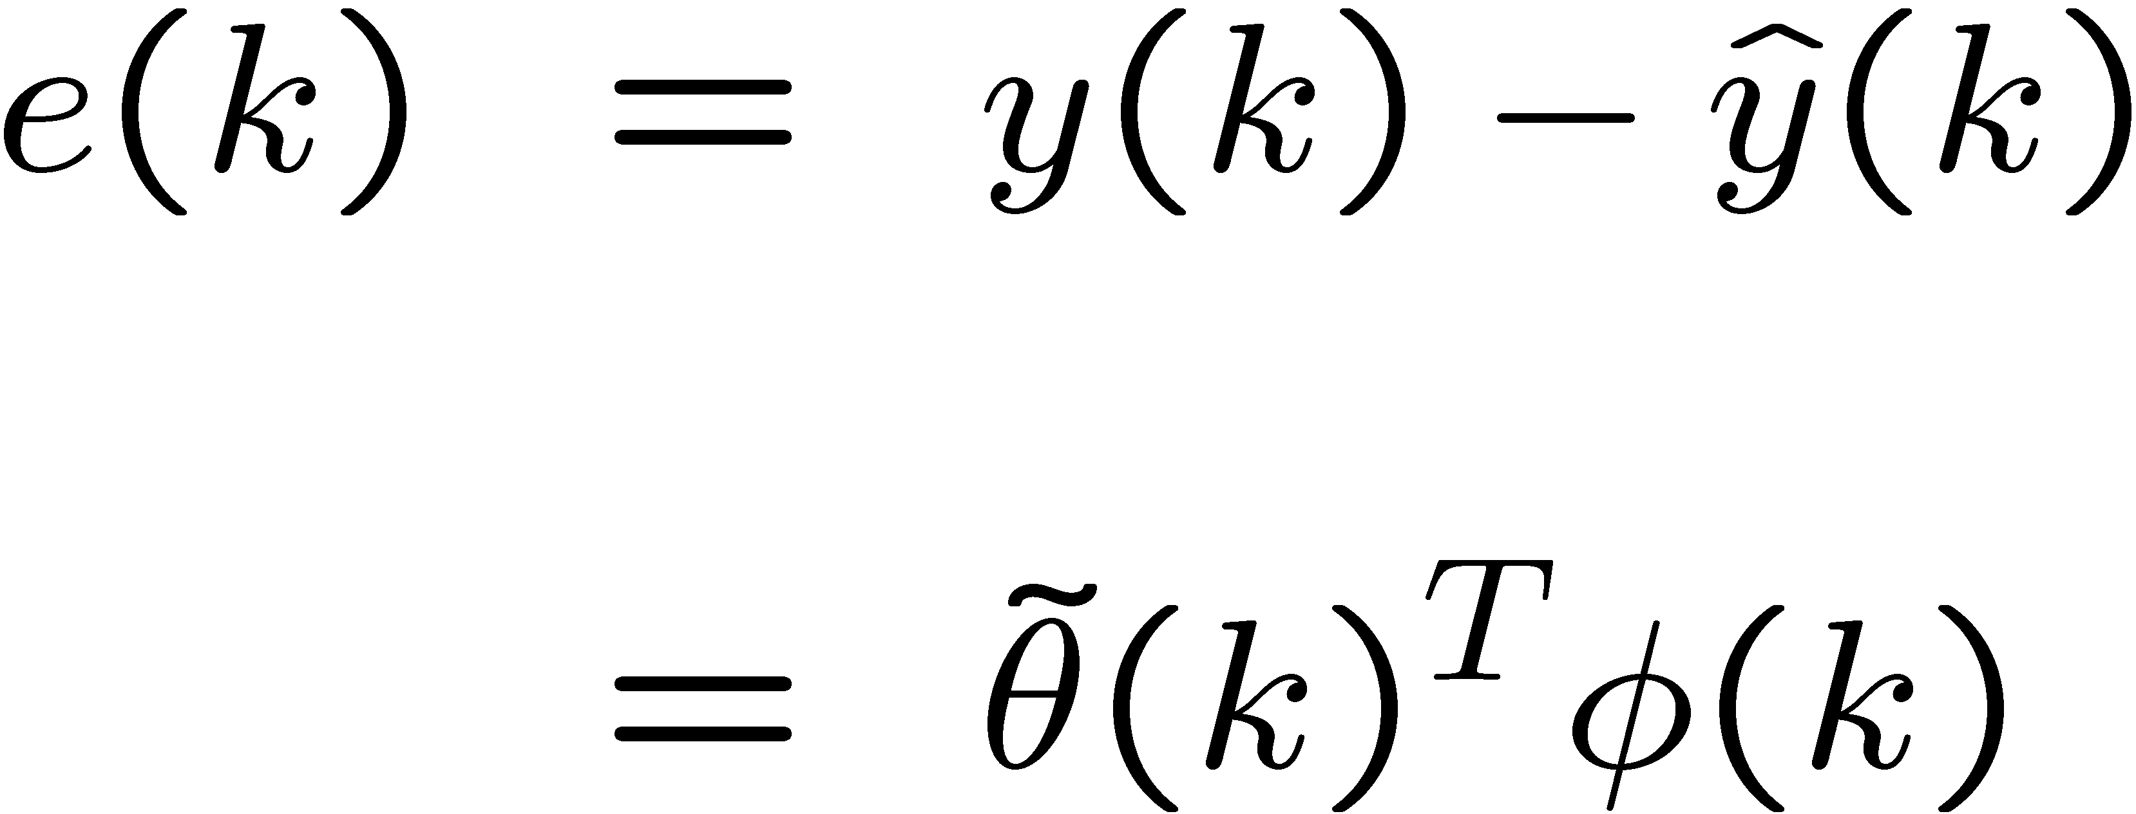
A-posteriori error convergence
We have concluded that the a-posteriori output error converges to zero:
where
What about the a-priori output error?

Slide 37
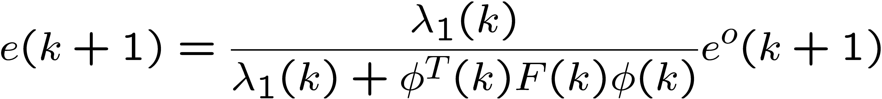


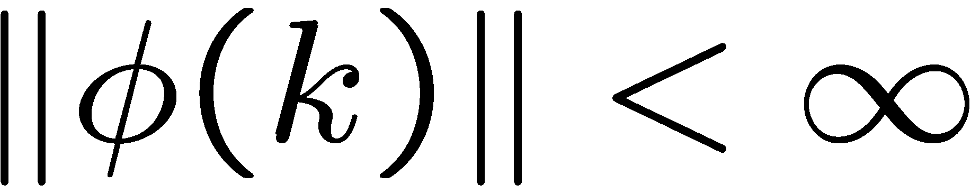

A-posteriori error convergence
Notice that
Therefore, does not necessarily
imply that
To prove , we need to first show

Slide 38
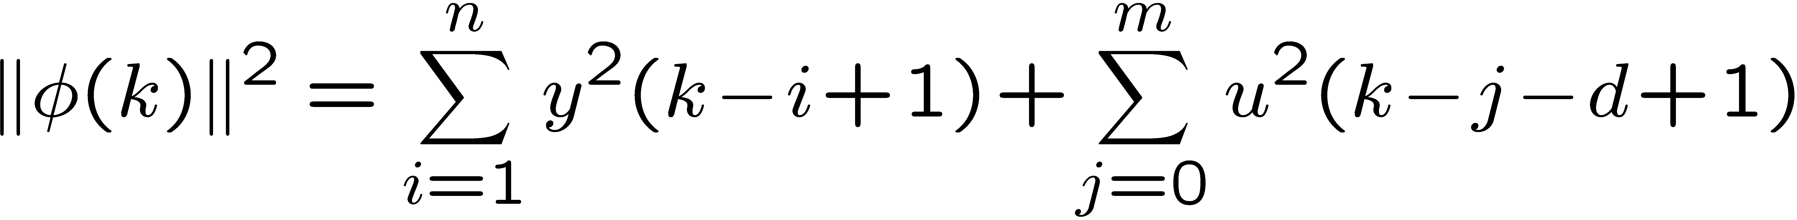
Bondedness of the regressor vector
Remember that:
Therefore,
By assumption,

Slide 39

Bondedness of the regressor vector
Since
and,
we only need to show that

Slide 40
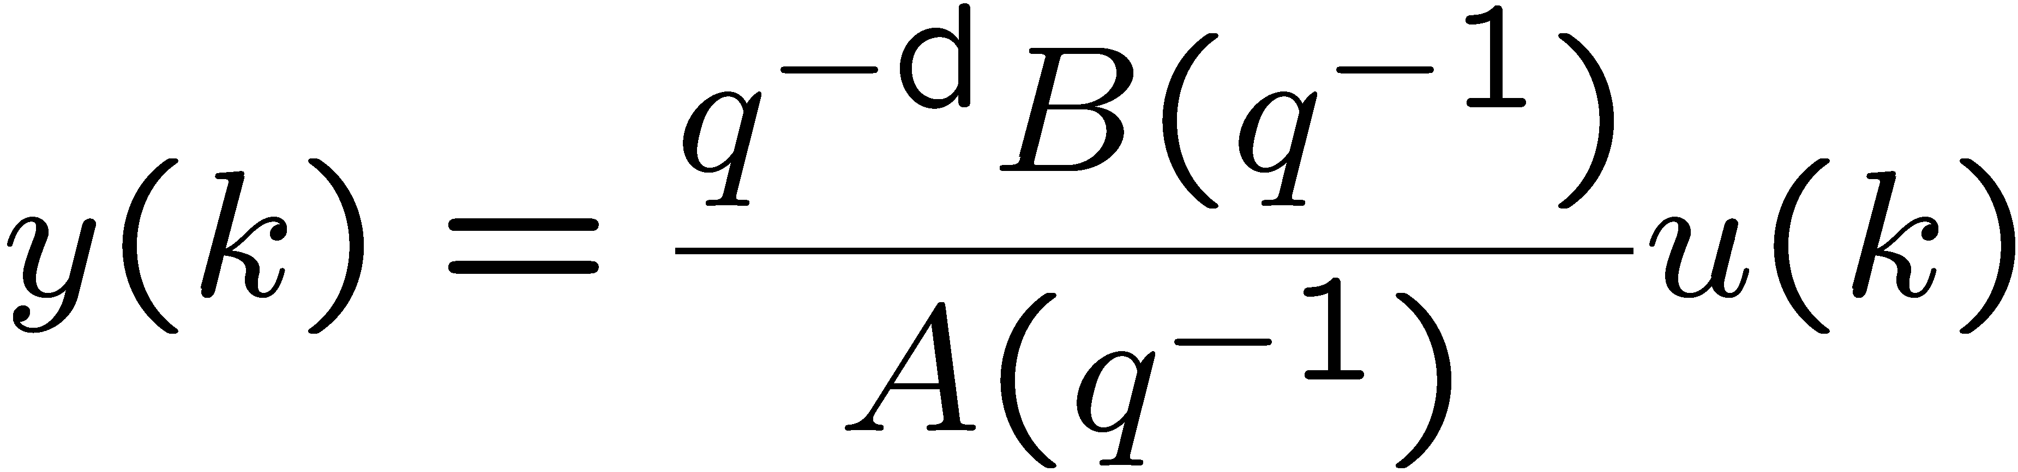
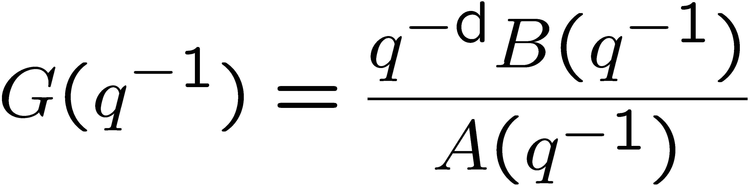
Bondedness of the regressor vector
Remember that:
is anti-Schur.
and
Therefore LTI system
is BIBO
Thus,

Slide 41
Additional Material (you are not responsible for this)
Proof that NL₁ is P-class

Slide 42
Equivalent feedback loop (review)
Recall that the NL block is not P-class
1
NL:

Slide 43
Solution: Modify the NL block (review)
Add a feedback term to NL to make it P-class
NL1:
We want to show:

Slide 44

Simplified Notation

Slide 45


Proof that NL₁ is P-class
From the summing junction, we have

Slide 46







Proof that NL₁ is P-class
Multiply the input of NL₁ by its output
NL:

Slide 47



Proof that NL₁ is P-class
From the previous slide
Define

Slide 48




Proof that NL₁ is P-class
From the previous slide

Slide 49





Proof that NL₁ is P-class
From the previous slide
Therefore
because
because

Slide 50





Proof that NL₁ is P-class
Now check the Popov inequality

